Slide 1


Vasileios Kottas
18/3

Slide 2

Outline
Executive Summary
Introduction
Methodology
Results
Conclusion
Appendix

Slide 3
Executive Summary
Summary of methodologies
Data collection
Data wrangling
Exploratory Data Analysis with Data Visualization
Exploratory Data Analysis with SQL
Building an interactive map with Folium
Building a Dashboard with Plotly Dash
Machine Learning Methods
Summary of all results
Exploratory Data Analysis results
Interactive analytics
Predictive analysis results

Slide 4
Introduction
Project background and context:
SpaceX, founded by Elon Musk in 2002, is a leading aerospace manufacturer and space transport company known for its innovative approach to space exploration. With a focus on affordability and sustainability, SpaceX has revolutionized the industry with its Falcon rocket family and pioneering work in rocket reusability. Notable achievements include successful cargo and crew missions to the International Space Station using the Dragon spacecraft. SpaceX continues to push boundaries with projects like the Starship spacecraft, aiming to enable crewed missions to Mars and beyond.
Problems you want to find answers:
Do different variables affect the success of first stage landing?
Does the success rate increase over the years?
What is the best method for binary classification?

Slide 5

Section 1

Slide 6
Methodology
Executive Summary
Data collection methodology:
A combination of API requests from SpaceX and Web Scraping from Wikipedia
Perform data wrangling
Filtering data and the missing values
Using One Hot Encoding to prepare the data
Perform exploratory data analysis (EDA) using visualization and SQL
Perform interactive visual analytics using Folium and Plotly Dash
Perform predictive analysis using classification models
Building, tuning and evaluating classification models

Slide 7
Data Collection
Data collection process involved a combination of API requests from SpaceX REST API and Web Scraping data from a table in SpaceX’s Wikipedia entry.
Data Columns are obtained by using SpaceX REST API: FlightNumber, Date, BoosterVersion, PayloadMass, Orbit, LaunchSite, Outcome, Flights, GridFins, Reused, Legs, LandingPad, Block, ReusedCount, Serial, Longitude, Latitude Data
Columns are obtained by using Wikipedia Web Scraping: Flight No., Launch site, Payload, PayloadMass, Orbit, Customer, Launch outcome, Version Booster, Booster landing, Date, Time

Slide 8
Data Collection – SpaceX API
Request data from SpaceX API
Decode using .json() and normalize using .json_normalize()
Construct the data into a dictionary
The Data collection was achieved using the following:
Requesting the Data by SpaceX API
Normalizing the data
Turn the data to a dictionary
Create a Dataframe
Filter the Data to include only Falcon 9 rockets
Replace the missing values using .mean() function
Replace missing values of the Payload Mass Column with the mean value using .mean()
Filter out all the other launches except Falcon 9
Create a Dataframe
Export the data to a CSV file
Github Data Collection API

Slide 9
Data Collection - Scraping
Requesting Falcon 9 launch data from Wikipedia
Creating a BeautifulSoup object from the HTML response
Extracting all column names from the HTML table header
The Data collection was achieved using the following:
Requesting the Data from Wikipedia
Create a BeautifulSoup object
Extract column names
Collect the data by parsing HTML tables
Turn into a dictionary
Create a Dataframe
Creating a dataframe from the dictionary
Constructing data we have obtained into a dictionary
Collecting the data by parsing HTML tables
Github url Data Collection with Web Scraping
Export the data to a CSV file

Slide 10
Data Wrangling
From the dataset, we had different cases for the booster's landing. Below are the cases:
True Ocean means the mission outcome was successfully landed to a specific region of the ocean, False Ocean meant unsuccessful landing.
True RTLS means the mission outcome was successfully landed to a ground pad False RTLS means the mission outcome was unsuccessfully landed to a ground pad.
True ASDS means the mission outcome was successfully landed on a drone ship False ASDS means the mission outcome was unsuccessfully landed on a drone ship.
During the processing of the data, the outcomes where converted into 1 for successful landing and 0 for unsuccessful.
Github URL Data wrangling

Slide 11
EDA with Data Visualization
Charts were plotted:
Flight Number vs. Payload Mass, Flight Number vs. Launch Site, Payload Mass vs. Launch Site, Orbit Type vs. Success Rate, Flight Number vs. Orbit Type, Payload Mass vs Orbit Type and Success Rate Yearly Trend
Scatter plots show the relationship between variables. If a relationship exists, they could be used in machine learning model.
Bar charts show comparisons among discrete categories. The goal is to show the relationship between the specific categories being compared and a measured value.
Line charts show trends in data over time (time series).
Github URL

Slide 12
Performed SQL queries:
Displaying the names of the unique launch sites in the space mission
Displaying 5 records where launch sites begin with the string ‘CCA'
Displaying the total payload mass carried by boosters launched by NASA (CRS) • Displaying average payload mass carried by booster version F9 v1.1
Listing the date when the first successful landing outcome in ground pad was achieved
Listing the names of the boosters which have success in drone ship and have payload mass greater than 4000 but less than 6000 • Listing the total number of successful and failure mission outcomes
Listing the names of the booster versions which have carried the maximum payload mass
Listing the failed landing outcomes in drone ship, their booster versions and launch site names for the months in year 2015
Ranking the count of landing outcomes (such as Failure (drone ship) or Success (ground pad)) between the date 2010-06-04 and 2017-03-20 in descending order
Github URL EDA WITH SQL
EDA with SQL

Slide 13
Build an Interactive Map with Folium
Markers of all Launch Sites:
Added Marker with Circle, Popup Label and Text Label of NASA Johnson Space Center using its latitude and longitude coordinates as a start location.
Added Markers with Circle, Popup Label and Text Label of all Launch Sites using their latitude and longitude coordinates to show their geographical locations and proximity to Equator and coasts.
Launch Sites Locations Analysis with Folium

Slide 14
Launch Sites Dropdown List: -
Added a dropdown list to enable Launch Site selection. Pie Chart showing Success Launches (All Sites/Certain Site): -
Added a pie chart to show the total successful launches count for all sites and the Success vs. Failed counts for the site, if a specific Launch Site was selected. Slider of Payload Mass Range: -
Added a slider to select Payload range. Scatter Chart of Payload Mass vs. Success Rate for the different Booster Versions: -
Added a scatter chart to show the correlation between Payload and Launch Success.
Build a Dashboard Application with Plotly Dash
Build a Dashboard with Plotly Dash

Slide 15
Predictive Analysis (Classification)
Creating a NumPy array from the column “Class” in data
Standardizing the data with StandardScaler, then fitting and transforming it
Splitting the data into training and testing sets with train_test_split function
Creating a GridSearchCV object with cv = 10 to find the best parameters
Applying GridSearchCV on LogReg, SVM, Decision Tree, and KNN models
Calculating the accuracy on the test data using the method .score() for all models Examining the confusion matrix for all models
Finding the method performs best by examining the Jaccard_score and F1_score metrics
Machine Learning Prediction

Slide 16
Results
Exploratory data analysis results
Interactive analytics demo in screenshots
Predictive analysis results

Slide 17

Section 2

Slide 18
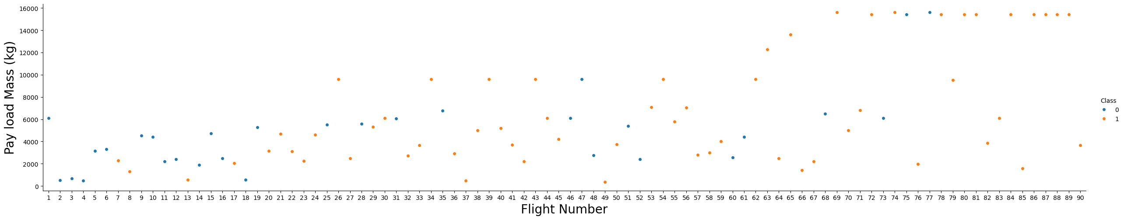
Flight Number vs. Launch Site
Explanation:
The earliest flights all failed while the latest flights all succeeded.
The CCAFS SLC 40 launch site has about a half of all launches. VAFB SLC 4E and KSC LC 39A have higher success rates.
It can be assumed that each new launch has a higher rate of success.

Slide 19
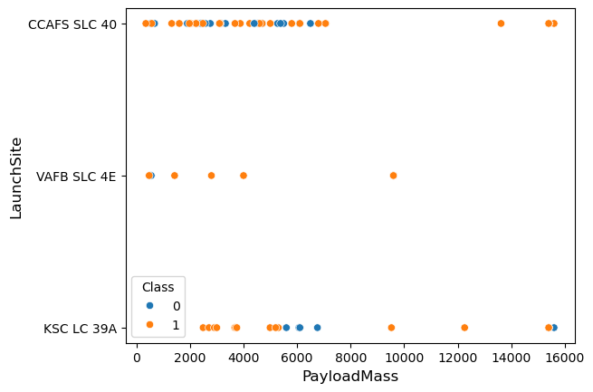
Payload vs. Launch Site
Explanation:
For every launch site the higher the payload mass, the higher the success rate.
Most of the launches with payload mass over 7000 kg were successful.
KSC LC 39A has a 100% success rate for payload mass under 5500 kg too.

Slide 20
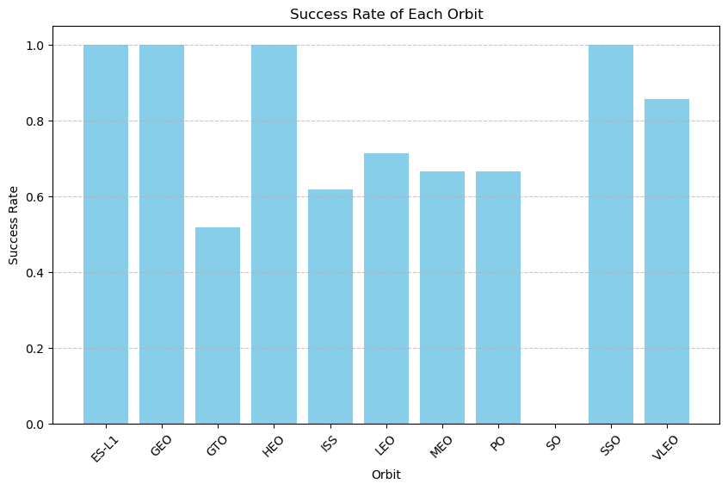
Success Rate vs. Orbit Type
Explanation:
Orbits with 100% success rate: - ES-L1, GEO, HEO, SSO
Orbits with 0% success rate: - SO
Orbits with success rate between 50% and 85%: - GTO, ISS, LEO, MEO, PO

Slide 21
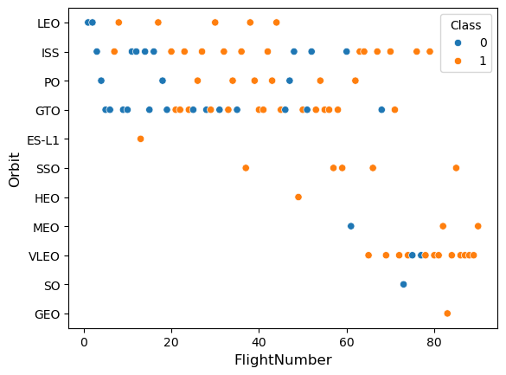
Flight Number vs. Orbit Type
Explanation:
In the LEO orbit the Success appears related to the number of flights; on the other hand, there seems to be no relationship between flight number when in GTO orbit

Slide 22
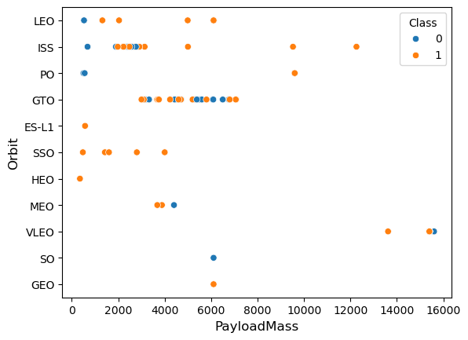
Payload vs. Orbit Type
Explanation:
Heavy payloads have a negative influence on GTO orbits and positive on GTO and Polar LEO (ISS) orbits.

Slide 23
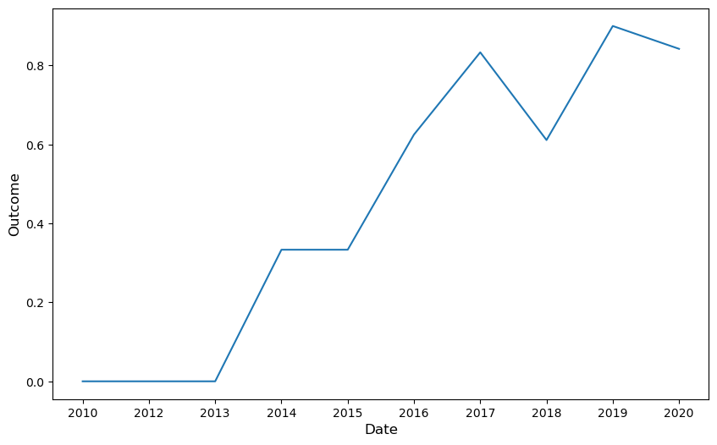
Launch Success Yearly Trend
Explanation:
The success rate since 2013 kept increasing till 2020.

Slide 24
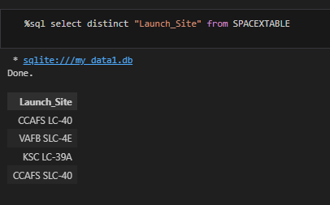
All Launch Site Names

Slide 25
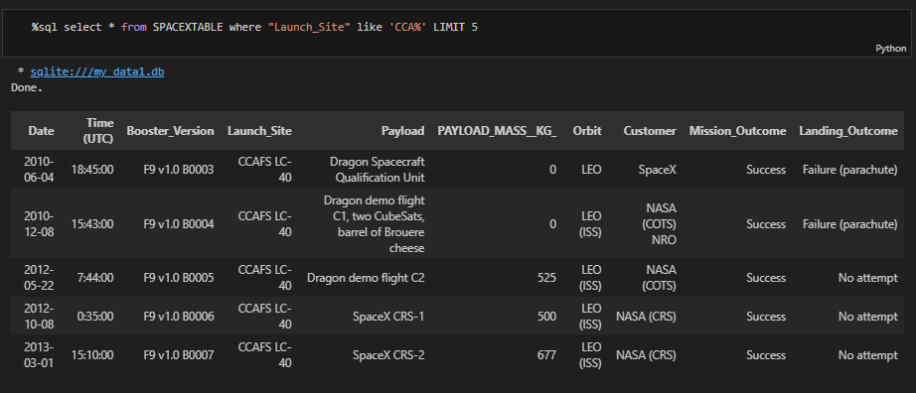
Launch Site Names Begin with 'CCA'

Slide 26
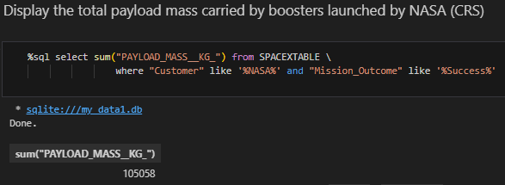
Total Payload Mass

Slide 27
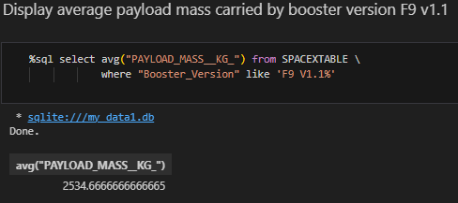
Average Payload Mass by F9 v1.1

Slide 28
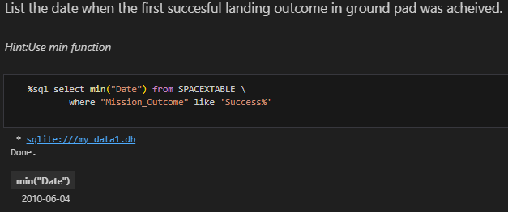
First Successful Ground Landing Date

Slide 29
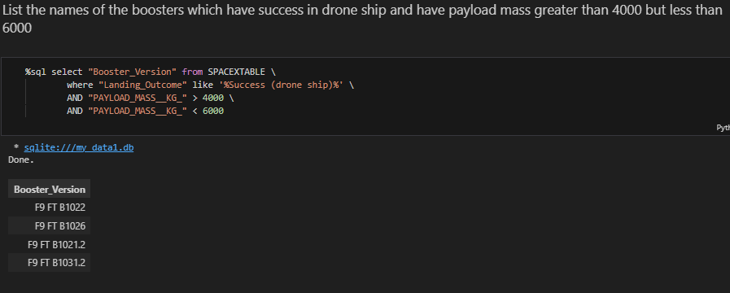
Successful Drone Ship Landing with Payload between 4000 and 6000

Slide 30
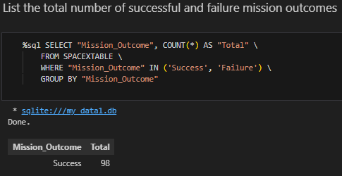
Total Number of Successful and Failure Mission Outcomes

Slide 31
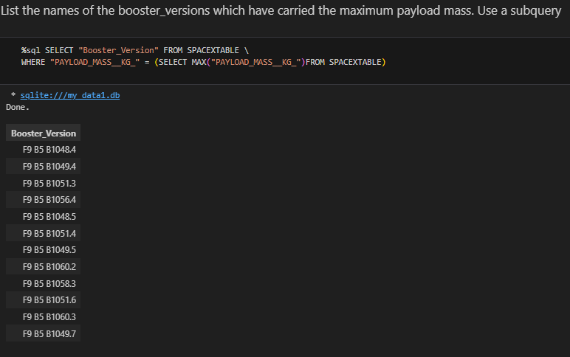
Boosters Carried Maximum Payload

Slide 32
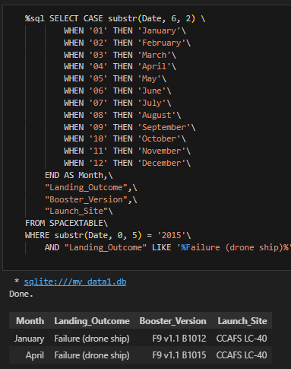
2015 Launch Records

Slide 33
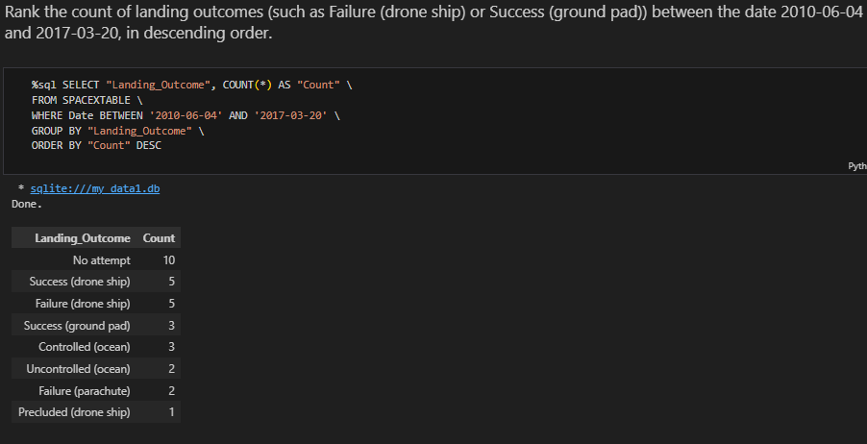
Rank Landing Outcomes Between 2010-06-04 and 2017-03-20

Slide 34

Section 3

Slide 35
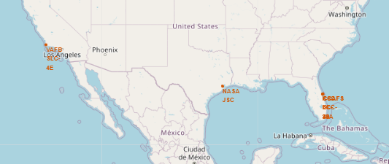
Launch sites in the global Map
Explanation:
All the launch sites are located close to the equator, since the earth moves father there.
All the launch sites are close to the cost and away from big cities, to minimize the danger of a rocket exploding and damaging people and properties.

Slide 36
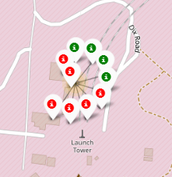
Colour-labeled launch records on the map
Explanation:
From the colour-labeled markers we should be able to easily identify which launch sites have relatively high success rates.
Green Marker = Successful Launch
Red Marker = Failed Launch

Slide 37
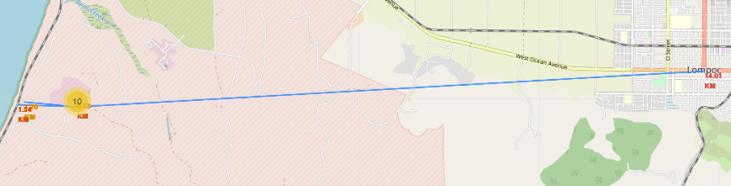
Distance from the launch site
Explanation:
The distance from the closest city is 14.01 km
From the closest highway is 1.29 km
From the railway is 1.34 km

Slide 38

Section 4

Slide 39
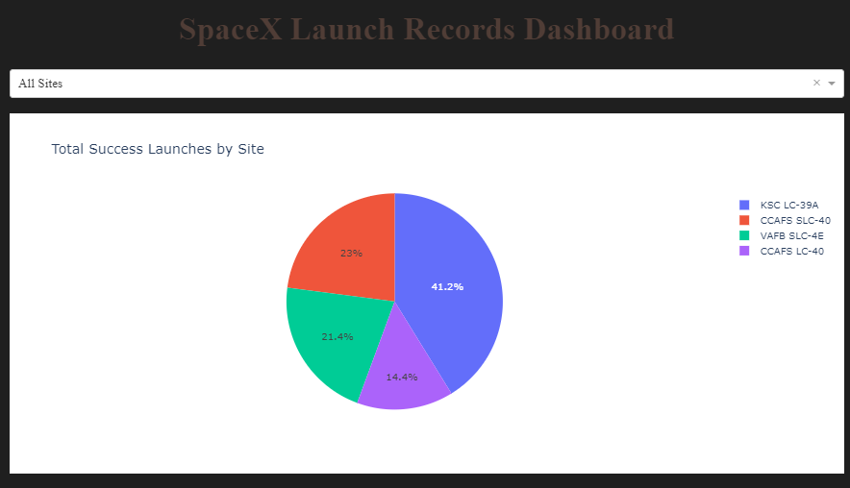
Pie Chart of all the Sites
Explanation:
The chart clearly shows that from all the sites, KSC LC-39A has the most successful launches.

Slide 40
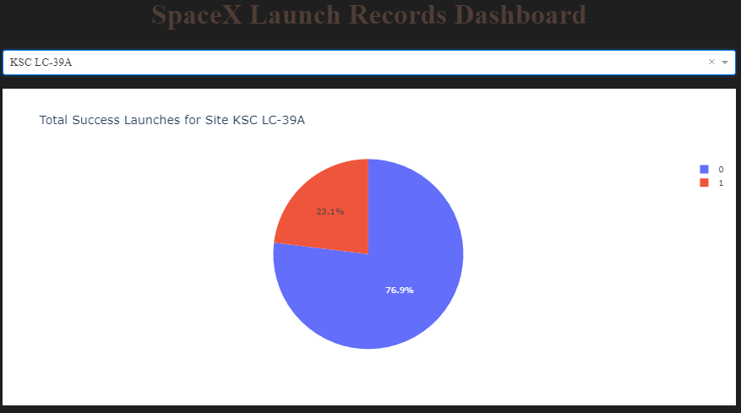
Launch site with highest launch success ratio
Explanation:
KSC LC-39A has the highest launch success rate (76.9%)

Slide 41
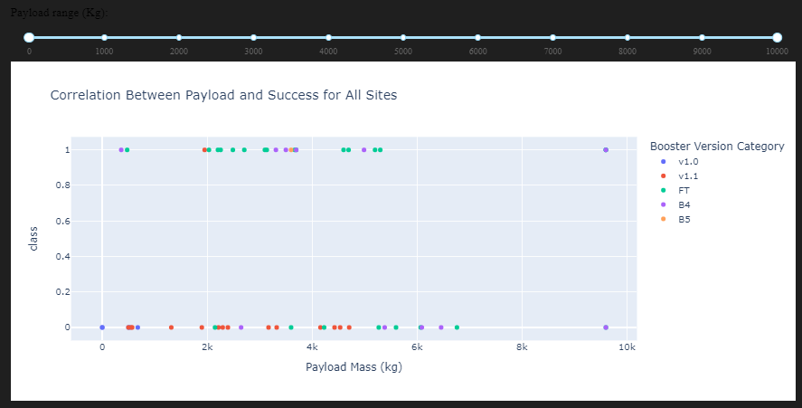
Payload Mass vs. Launch Outcome for all sites
The charts show that payloads between 2000 and 5500 kg have the highest success rate.

Slide 42

Section 5

Slide 43
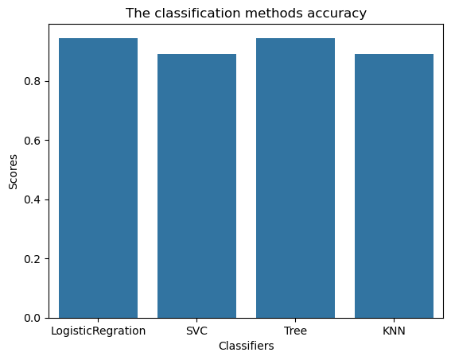
Classification Accuracy
As we can see the logistic regression method gives the best results.

Slide 44
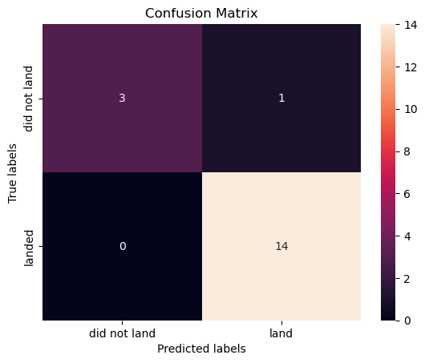
Confusion Matrix
Explanation:
Examining the confusion matrix, we see that logistic regression can distinguish between the different classes. We see that the major problem is false positives.

Slide 45
Conclusions
Launches with a low payload mass show better results than launches with a larger payload mass.
Most of launch sites are in proximity to the Equator line and all the sites are in very close proximity to the coast.
The success rate of launches increases over the years.
KSC LC-39A has the highest success rate of the launches from all the sites.

Slide 46


